Slide 1
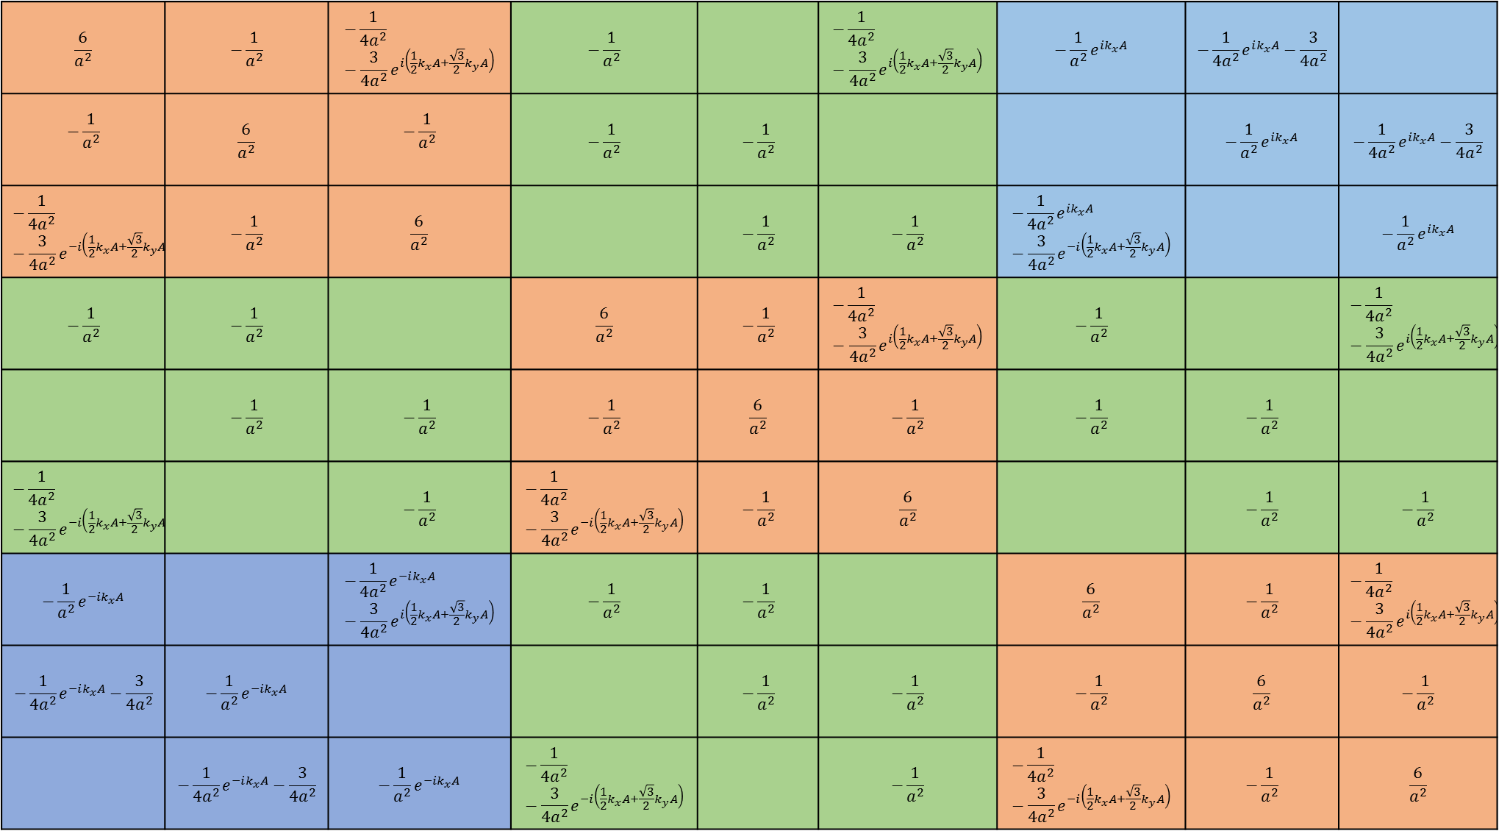
$$\frac{6}{a^{2}}$$ | $$−\frac{1}{a^{2}}$$ | $$−\frac{1}{{4a}^{2}}−\frac{3}{{4a}^{2}}e^{i\left({\frac{1}{2}k}_{x}A+\frac{\sqrt{3}}{2}k_{y}A\right)}$$ | $$−\frac{1}{a^{2}}$$ |  | $$−\frac{1}{{4a}^{2}}−\frac{3}{{4a}^{2}}e^{i\left({\frac{1}{2}k}_{x}A+\frac{\sqrt{3}}{2}k_{y}A\right)}$$ | $$−\frac{1}{a^{2}}e^{ik_{x}A}$$ | $$−\frac{1}{4a^{2}}e^{ik_{x}A}−\frac{3}{{4a}^{2}}$$
$$−\frac{1}{a^{2}}$$ | $$\frac{6}{a^{2}}$$ | $$−\frac{1}{a^{2}}$$ | $$−\frac{1}{a^{2}}$$ | $$−\frac{1}{a^{2}}$$ |  |  | $$−\frac{1}{a^{2}}e^{ik_{x}A}$$ | $$−\frac{1}{4a^{2}}e^{ik_{x}A}−\frac{3}{{4a}^{2}}$$
$$−\frac{1}{{4a}^{2}}−\frac{3}{{4a}^{2}}e^{−i\left({\frac{1}{2}k}_{x}A+\frac{\sqrt{3}}{2}k_{y}A\right)}$$ | $$−\frac{1}{a^{2}}$$ | $$\frac{6}{a^{2}}$$ |  | $$−\frac{1}{a^{2}}$$ | $$−\frac{1}{a^{2}}$$ | $$−\frac{1}{4a^{2}}e^{ik_{x}A}−\frac{3}{{4a}^{2}}e^{−i\left({\frac{1}{2}k}_{x}A+\frac{\sqrt{3}}{2}k_{y}A\right)}$$ |  | $$−\frac{1}{a^{2}}e^{ik_{x}A}$$
$$−\frac{1}{a^{2}}$$ | $$−\frac{1}{a^{2}}$$ |  | $$\frac{6}{a^{2}}$$ | $$−\frac{1}{a^{2}}$$ | $$−\frac{1}{{4a}^{2}}−\frac{3}{{4a}^{2}}e^{i\left({\frac{1}{2}k}_{x}A+\frac{\sqrt{3}}{2}k_{y}A\right)}$$ | $$−\frac{1}{a^{2}}$$ |  | $$−\frac{1}{{4a}^{2}}−\frac{3}{{4a}^{2}}e^{i\left({\frac{1}{2}k}_{x}A+\frac{\sqrt{3}}{2}k_{y}A\right)}$$
 | $$−\frac{1}{a^{2}}$$ | $$−\frac{1}{a^{2}}$$ | $$−\frac{1}{a^{2}}$$ | $$\frac{6}{a^{2}}$$ | $$−\frac{1}{a^{2}}$$ | $$−\frac{1}{a^{2}}$$ | $$−\frac{1}{a^{2}}$$
$$−\frac{1}{{4a}^{2}}−\frac{3}{{4a}^{2}}e^{−i\left({\frac{1}{2}k}_{x}A+\frac{\sqrt{3}}{2}k_{y}A\right)}$$ |  | $$−\frac{1}{a^{2}}$$ | $$−\frac{1}{{4a}^{2}}−\frac{3}{{4a}^{2}}e^{−i\left({\frac{1}{2}k}_{x}A+\frac{\sqrt{3}}{2}k_{y}A\right)}$$ | $$−\frac{1}{a^{2}}$$ | $$\frac{6}{a^{2}}$$ |  | $$−\frac{1}{a^{2}}$$ | $$−\frac{1}{a^{2}}$$
$$−\frac{1}{a^{2}}e^{−ik_{x}A}$$ |  | $$−\frac{1}{4a^{2}}e^{−ik_{x}A}−\frac{3}{{4a}^{2}}e^{i\left({\frac{1}{2}k}_{x}A+\frac{\sqrt{3}}{2}k_{y}A\right)}$$ | $$−\frac{1}{a^{2}}$$ | $$−\frac{1}{a^{2}}$$ |  | $$\frac{6}{a^{2}}$$ | $$−\frac{1}{a^{2}}$$ | $$−\frac{1}{{4a}^{2}}−\frac{3}{{4a}^{2}}e^{i\left({\frac{1}{2}k}_{x}A+\frac{\sqrt{3}}{2}k_{y}A\right)}$$
$$−\frac{1}{4a^{2}}e^{−ik_{x}A}−\frac{3}{{4a}^{2}}$$ | $$−\frac{1}{a^{2}}e^{−ik_{x}A}$$ |  |  | $$−\frac{1}{a^{2}}$$ | $$−\frac{1}{a^{2}}$$ | $$−\frac{1}{a^{2}}$$ | $$\frac{6}{a^{2}}$$ | $$−\frac{1}{a^{2}}$$
 | $$−\frac{1}{4a^{2}}e^{−ik_{x}A}−\frac{3}{{4a}^{2}}$$ | $$−\frac{1}{a^{2}}e^{−ik_{x}A}$$ | $$−\frac{1}{{4a}^{2}}−\frac{3}{{4a}^{2}}e^{−i\left({\frac{1}{2}k}_{x}A+\frac{\sqrt{3}}{2}k_{y}A\right)}$$ |  | $$−\frac{1}{a^{2}}$$ | $$−\frac{1}{{4a}^{2}}−\frac{3}{{4a}^{2}}e^{−i\left({\frac{1}{2}k}_{x}A+\frac{\sqrt{3}}{2}k_{y}A\right)}$$ | $$−\frac{1}{a^{2}}$$ | $$\frac{6}{a^{2}}$$
(1, 1)
(1, 2)
(1, 3)
(1, 4)
(1, 5)
(1, 6)
(1, 7)
(1, 8)
(1, 9)
(2, 1)
(2, 2)
(2, 3)
(2, 4)
(2, 5)
(2, 6)
(2, 7)
(2, 8)
(2, 9)
(3, 1)
(3, 2)
(3, 3)
(3, 4)
(3, 5)
(3, 6)
(3, 7)
(3, 8)
(3, 9)
(4, 1)
(4, 2)
(4, 3)
(4, 4)
(4, 5)
(4, 6)
(4, 7)
(4, 8)
(4, 9)
(5, 1)
(5, 2)
(5, 3)
(5, 4)
(5, 5)
(5, 6)
(5, 7)
(5, 8)
(5, 9)
(6, 1)
(6, 2)
(6, 3)
(6, 4)
(6, 5)
(6, 6)
(6, 7)
(6, 8)
(6, 9)
(7, 1)
(7, 2)
(7, 3)
(7, 4)
(7, 5)
(7, 6)
(7, 7)
(7, 8)
(7, 9)
(8, 1)
(8, 2)
(8, 3)
(8, 4)
(8, 5)
(8, 6)
(8, 7)
(8, 8)
(8, 9)
(9, 1)
(9, 2)
(9, 3)
(9, 4)
(9, 5)
(9, 6)
(9, 7)
(9, 8)
(9, 9)

